Slide 1
the MSR-INRIA Joint Centre
2006-2012
Jean-Jacques Lévy
September 26, 2012
msr-inria.inria.fr

Slide 2
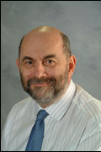

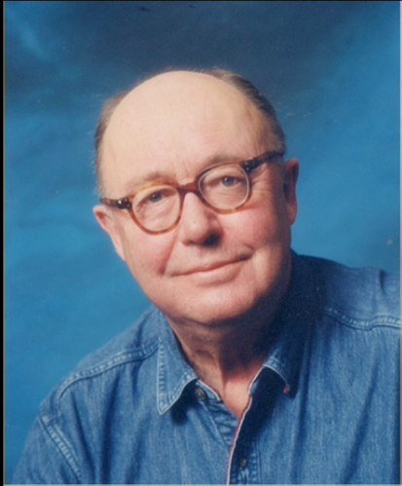






Politics
INRIA
MSR Cambridge
Eric Boustouller
Joint Centre
Gérard Huet
Stephen Emmott
Ken Wood
Gérard Giraudon
Jean Vuillemin
Marc Jalabert
Gérard Giraudon
Claude Puech
Bernard Ourghanlian

Slide 3
Politics
INRIA
MSR Cambridge
Eric Boustouller
Gérard Huet
Jean Vuillemin
Joint Centre
J.-J. Lévy
Stephen Emmott
Ken Wood
Malik Ghallab
Claude Puech
Marc Jalabert
Michel Bidoit
Gérard Giraudon
Bernard Ourghanlian

Slide 4
Politics
INRIA
MSR Cambridge
Michel Bidoit
Eric Boustouller
Stephen Emmott
Gérard Giraudon
Gérard Huet
Marc Jalabert
Jean Vuillemin
Ken Wood
Joint Centre
J.-J. Lévy
Andrew Blake
Fabrizio Gagliardi
Malik Ghallab
Claude Puech
Bernard Ourghanlian
Nozha Boujemaa
Thomas Serval
Bruno Sportisse

Slide 5
Politics
INRIA
MSR Cambridge
Michel Bidoit
Eric Boustouller
Stephen Emmott
Malik Ghallab
Gérard Giraudon
Gérard Huet
Marc Jalabert
Thomas Serval
Jean Vuillemin
Ken Wood
Joint Centre
J.-J. Lévy
Andrew Blake
Andrew Blake
Fabrizio Gagliardi
Claude Kirchner
Pascal Guitton
Bernard Ourghanlian
Nozha Boujemaa
Jean Ferré
Bruno Sportisse

Slide 6
Politics
INRIA
MSR Cambridge
Michel Bidoit
Eric Boustouller
Stephen Emmott
Malik Ghallab
Gérard Giraudon
Gérard Huet
Marc Jalabert
J.-J. Lévy
Thomas Serval
Bruno Sportisse
Jean Vuillemin
Ken Wood
Joint Centre
Laurent Massoulié
Andrew Blake
Andrew Blake
Fabrizio Gagliardi
Claude Kirchner
Pascal Guitton
Bernard Ourghanlian
Nozha Boujemaa
Jean Ferré

Slide 7
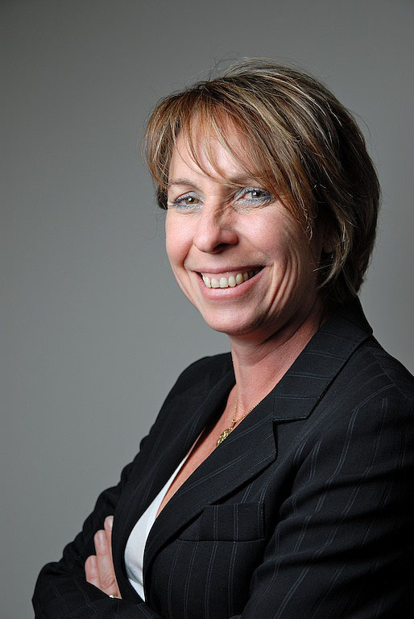
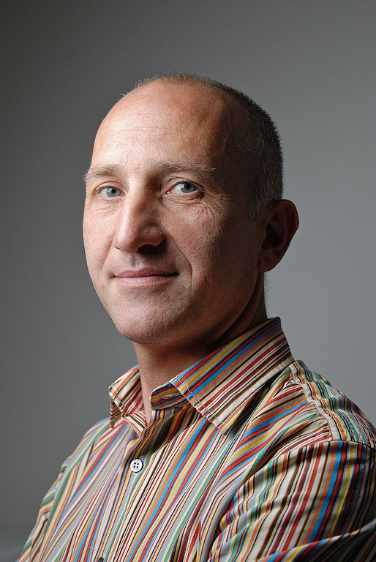
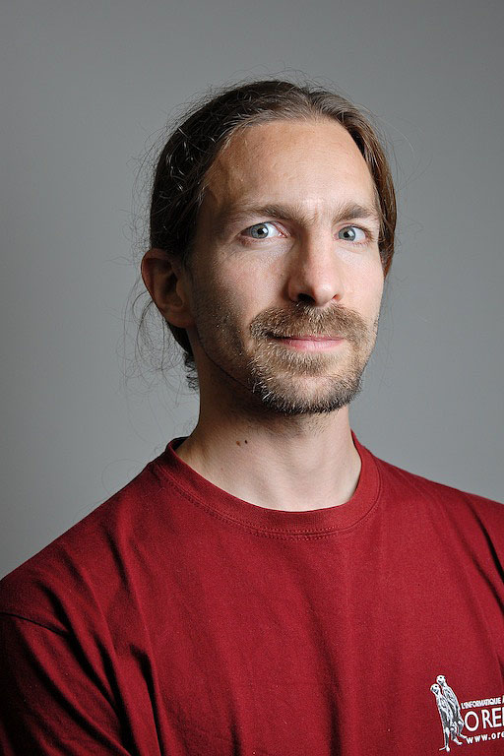
Management
  Francois Lhémery
  Luc Grateau
  Martine Thirion
  Faranak Grangé
  Pierre-Louis Xech
  Guillaume Rousse
  Inria Saclay
  MS France

Slide 8
Projects
Track A (truthworthy computing)
  Math. Components (2006)
  Security (2006)
  TLA+ (2006)
Track B (interaction with scientific data)
  DDMF (2007)
  ReActivity (2008-2010)
  Adaptative search (2008)
  Image & video mining (2010)
  4D Cardiac images (2012)
Track C (cloud computing)
  A-brain (2011)

Slide 9
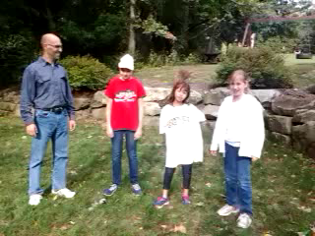
Feit-Thompson success
collective effort MSR-Inria and others
Victory dance of professor Avigad (CMU)

Slide 10
My view of research
practice
fundamental
applicative
theory

Slide 11
People
  25-30 phd’s (5-10 self funded) + 40 postdocs
  Inria: 6 CR2 (Chaudury, Corin, Mahboubi, Melquiond, Rezk, Tassi) + 2 CR1 (Bhargavan, Hansen)
  1 hired at MSRR (Henry)
  4 ERC grants (Ponce, Bhargavan, Ayache, Laptev)
Pubs
upto 10% of POPL papers (2009) + pl (ICFP, ESOP) + logic confs (ITP, TPHOL)
invasion of security conferences (CSF, CCS, TGC)
top at ISSAC
vision ++
AI conferences
Software
ssreflect 1.4
tlaps 1.0
ddmf 1.7

Slide 12
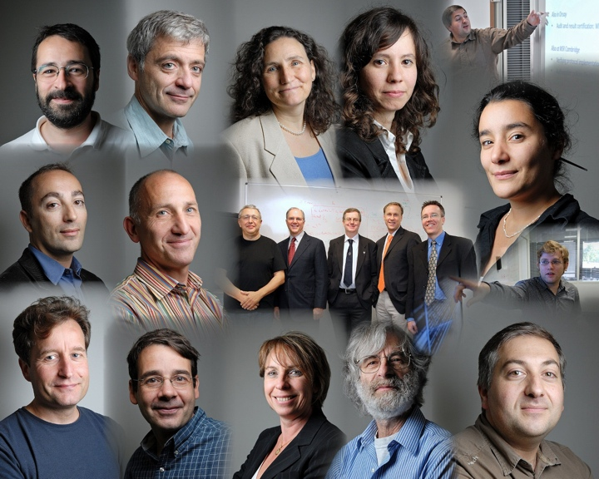
People
  25-30 phd’s (5-10 self funded)
  40 postdocs
  5 hired at Inria + Karthik
  1 hired at MSR

Slide 13
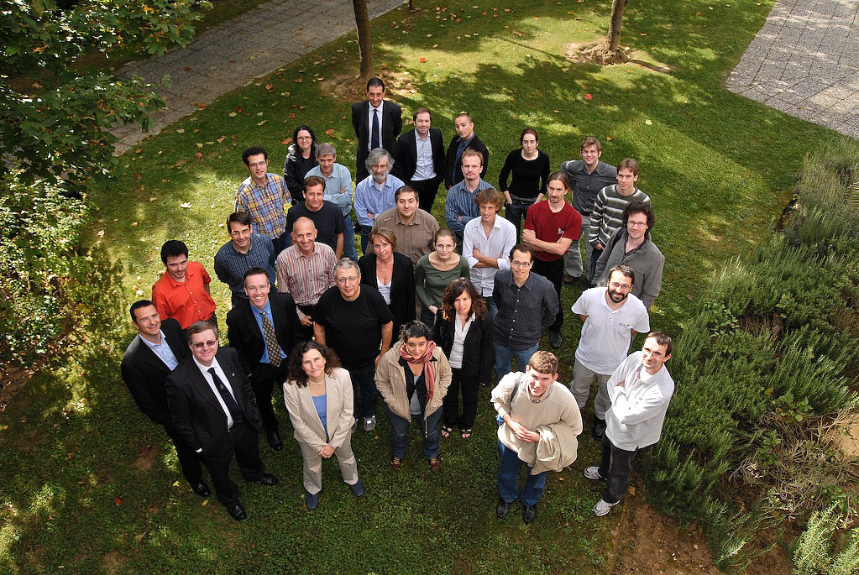

Slide 14


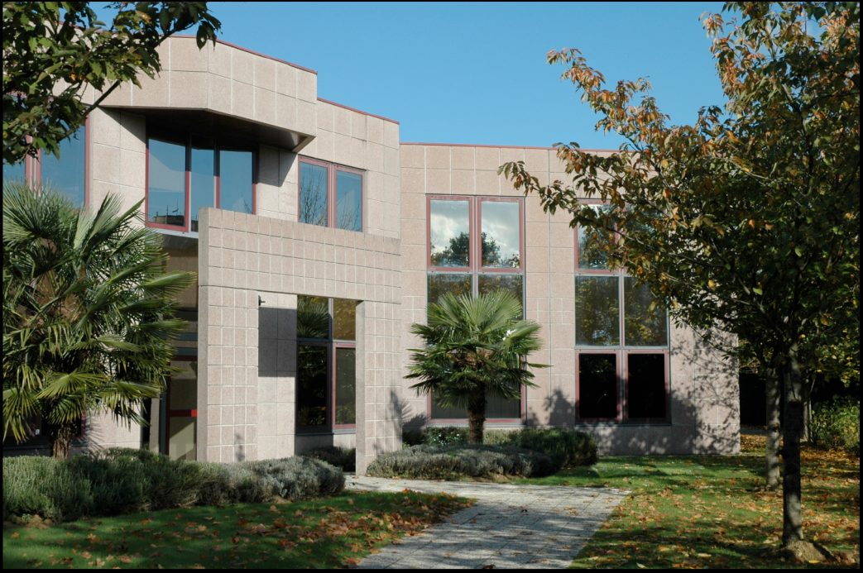
Future in 2007
  30 resident researchers
  tight links with French academia (phD, post-doc)
  develop useful research for scientific community
  provide public tools (BSD-like license)
  become a new and attractive pole in CS research
  and source of spin off companies

Slide 15


Viva el new Directeur !
Un grand merci à tous !

Slide 16


