Slide 1
Proofs, Security, and Computational Sciences
Jean-Jacques Lévy
December 3, 2010
Trento
msr-inria.inria.fr

Slide 2
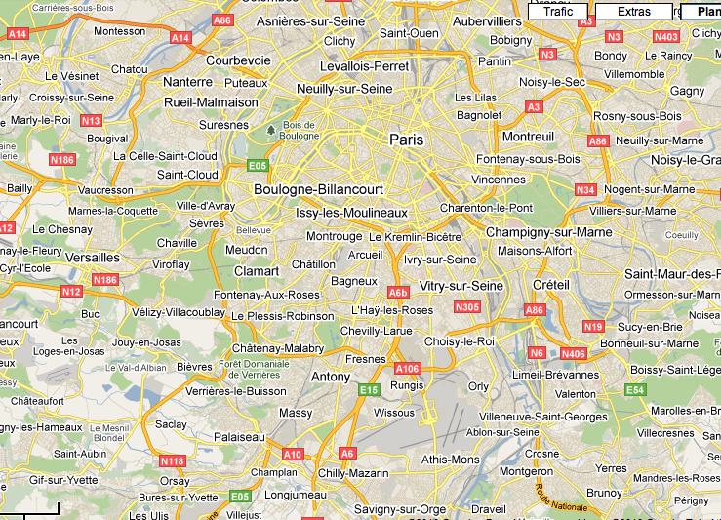
Plateau de Saclay

Slide 3
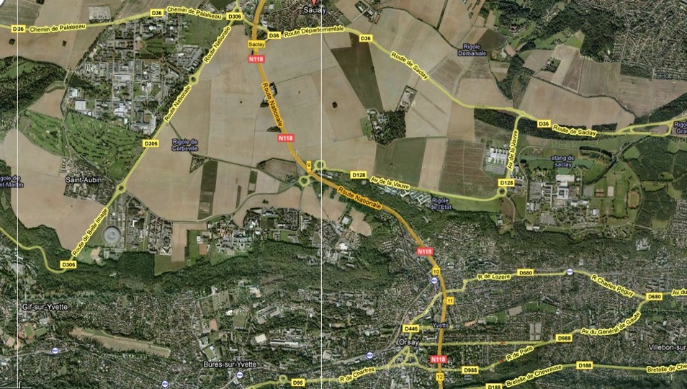
Localization
= long term investment
the plateau de Saclay
Paris
CEA
Polytechnique
INRIA
Supelec
LRI-Orsay
RER B
IHÉS

Slide 4
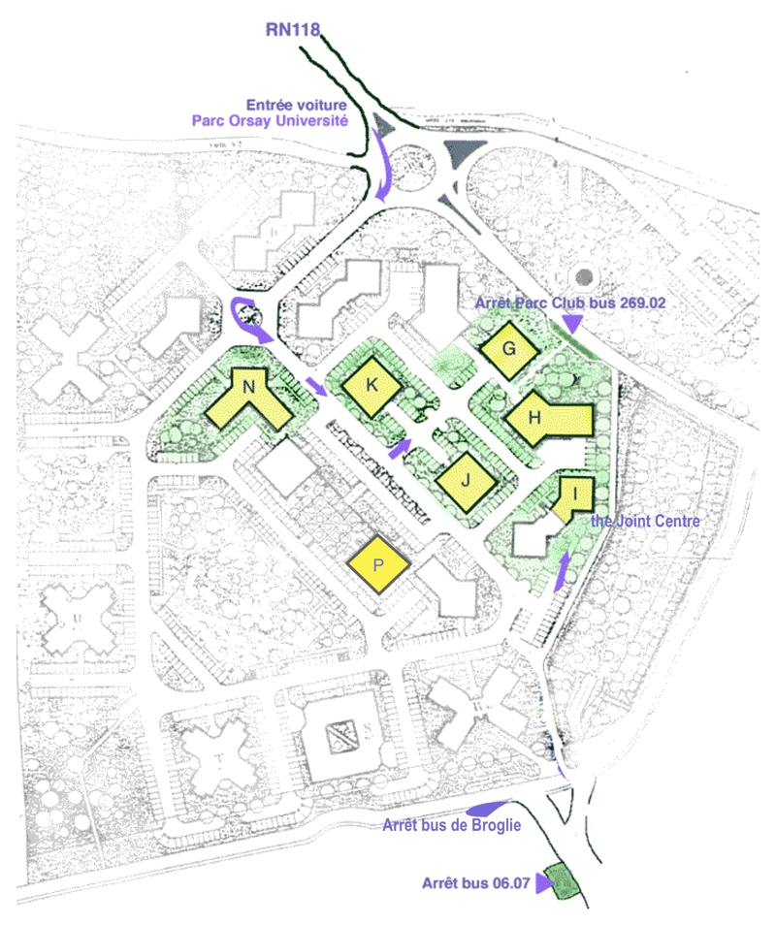
Campus
Bus 269-02
super <= 10am
also bus 06-07
6mn
Paris >= 30mn

Slide 5
Research
Track A
  Math. Components (see Enrico Tassi’s talk)
  Security
  TLA+
Track B
  DDMF (see Frédéric Chyzak’s talk)
  ReActivity
  Adaptative search
  Image & video mining
  Action Azure

Slide 6
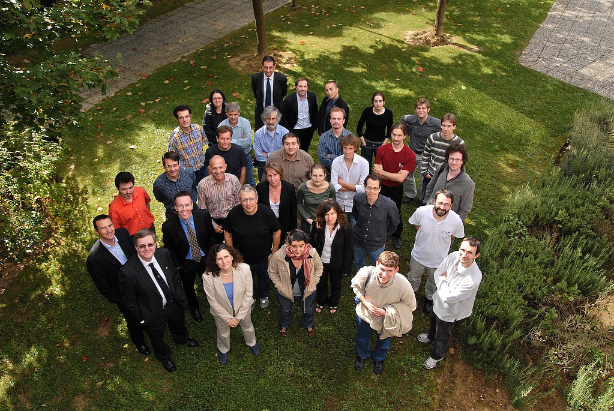

Slide 7
Track A
Software Security
Trustworthy Computing

Slide 8
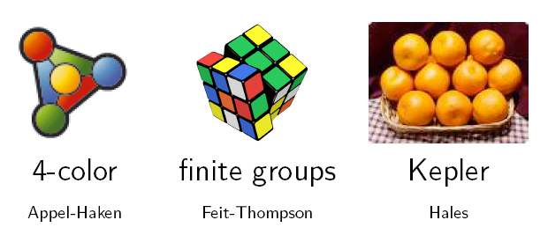
Mathematical components
Georges Gonthier, MSRC
Assia Mahboubi, INRIA Saclay/LIX
Y. Bertot, L. Rideau, L. Théry, INRIA Sophia
Iona Pasca, INRIA Sophia
François Garillot, MSR-INRIA (PhD)
Cyril Cohen, ENS Cachan (PhD)
Enrico Tassi, MSR-INRIA (postdoc)
Benjamin Werner, INRIA Saclay/LIX
formal proofs of math theorems with long proofs
  4 color theorem (3.5 Gonthier-years)
  Feit-Thompson theorem (3 MathComp-years – under progress)
  Hales theorem
computational proofs
  higher-order logic allows
programming within it
  Coq proof-assistant
now also Formath EU project (Chalmers, Bologna, etc.)

Slide 9

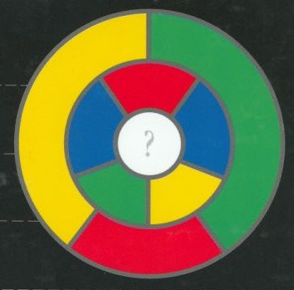
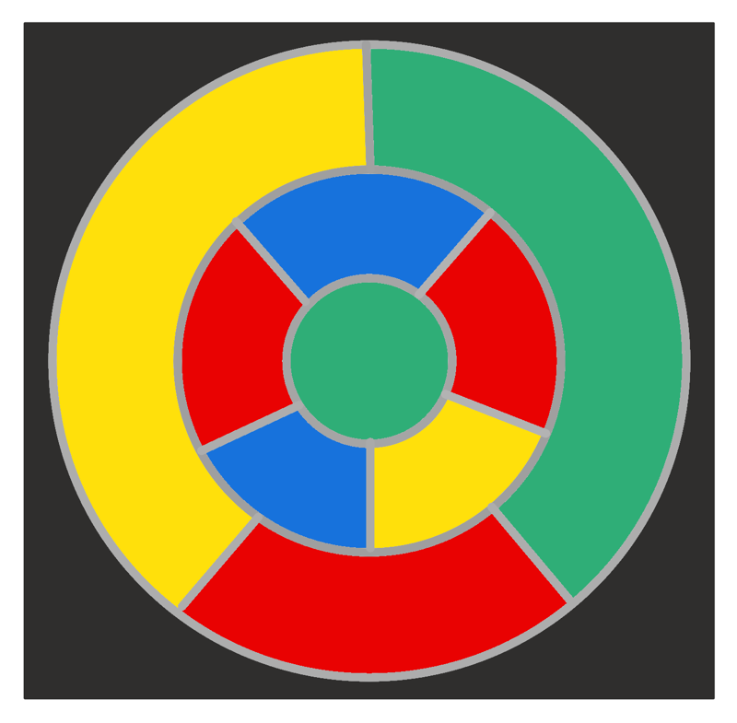
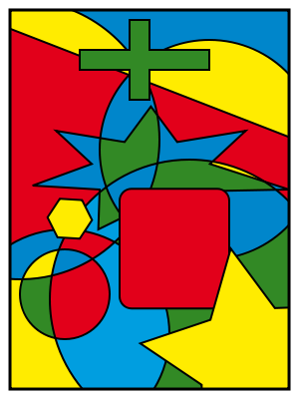
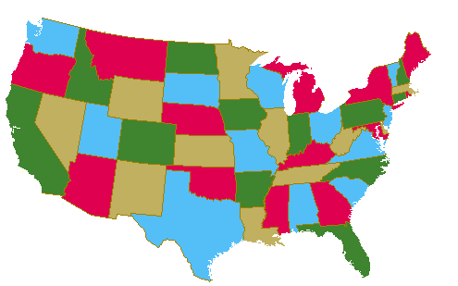
4 colors
???
correct

Slide 10
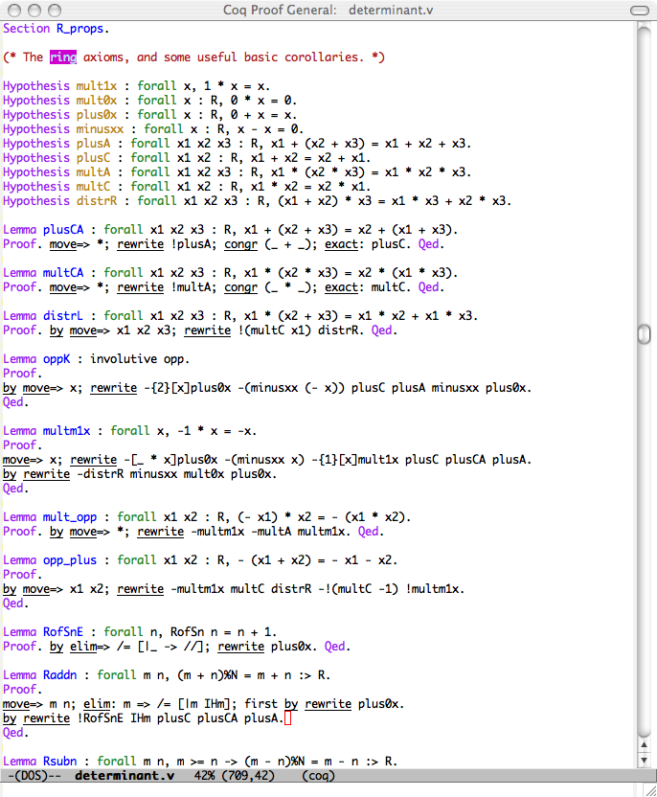
linear
algebra

Slide 11
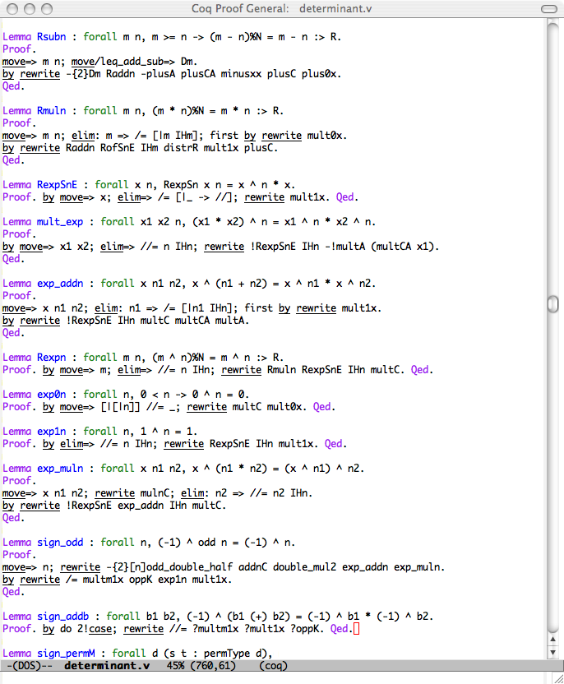
linear
algebra

Slide 12
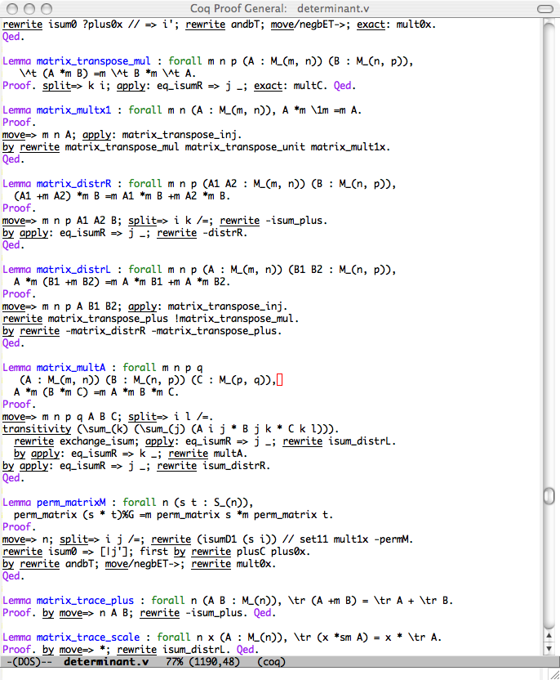
linear
algebra

Slide 13
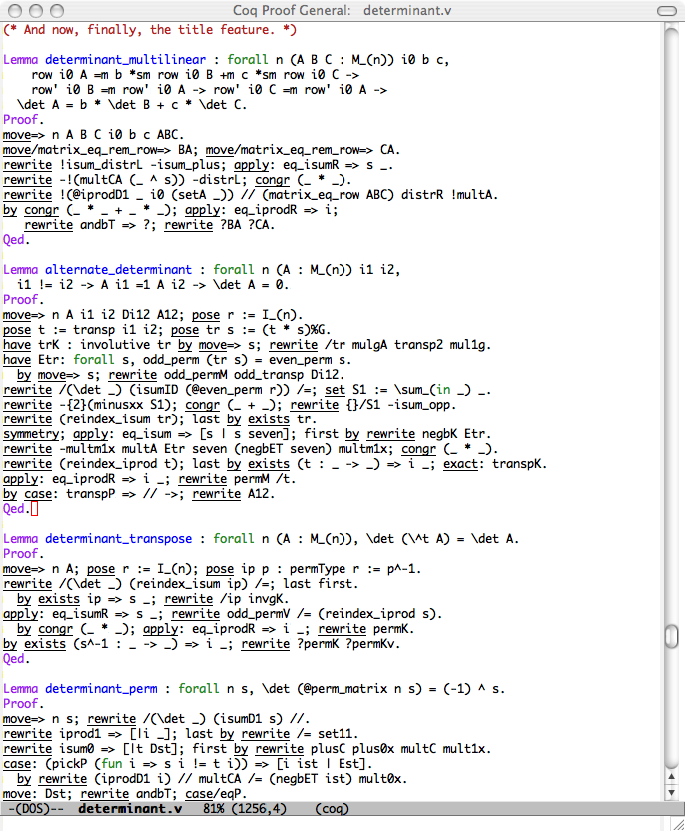
linear
algebra

Slide 14
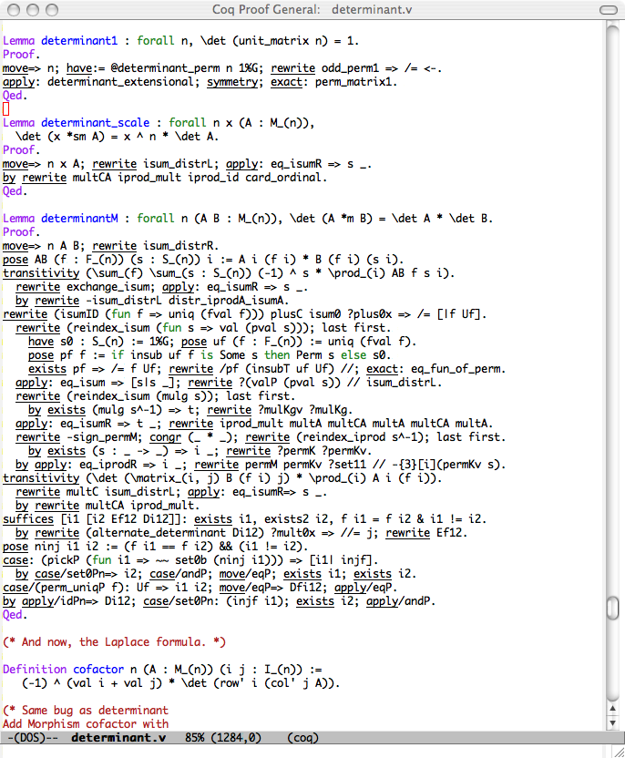
linear
algebra

Slide 15
Secure Distributed Comp.
Cédric Fournet, MSRC
Karthik Bhargavan, INRIA Rocq.
G. Barthe, IMDEA, Bruno Blanchet, INRIA/ENS
B. Grégoire, S. Zanella, INRIA Sophia
James Leifer, INRIA Rocq.
Jean-Jacques Lévy, INRIA Rocq.
Tamara Rezk, INRIA Sophia
Francesco Zappa Nardelli, INRIA Rocq.
Nataliya Guts, MSR-INRIA (PhD)
Jérémy Planul, MSR-INRIA (PhD)
  programming with secured communications
  certified compiler from high-level primitives to low-level crypto-protocols
  formal proofs of probabilistic protocols

Slide 16
Specs, Code, and Formal Tools
Casper
Athena
NRL
Cryptyc
Securify
AVISPA
Hand Proofs
Scyther
Protocol Standards
ProVerif (’01)
CryptoVerif (‘06)
F7 (’08)
TLS
Kerberos
Computational Analyses
Symbolic Analyses
WS-Security
IPsec
SSH
SMT Solvers
ML
F#
Ocaml
Ruby
Theorem Provers
Model
Checkers
Java
C/C++
C#
General Verification
Protocol Implementations and Applications

Slide 17
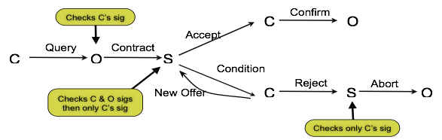
Secure Distributed Comp.
  secure implementations for typed session abstractions (v1 and v2)
  cryptographic enforcement of information-flow security
  secure Audit Logs
  automated verifications of protocol implementations (TLS)
  CertiCrypt: Formal Proofs for Computational Cryptography

Slide 18
Verification of TLS implementation
Firefox
Apache
CClient
CServer
  Firefox + Apache
  certified client CClient + certified server CServer
  Test functional features of Firefox + CServer and CClient + Apache
  Prove security property of CC + CS
  by translation to CryptoVerif [Bruno Blanchet]
  automatic translation from Caml + assertion to CryptoVerif (fs2cv)

Slide 19
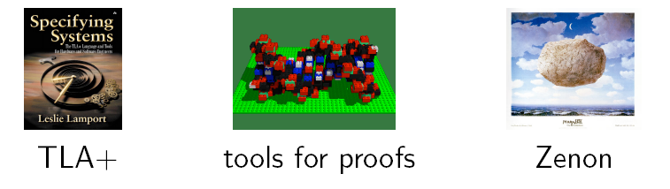
Tools for Formal Proofs
Damien Doligez, INRIA Rocq.
Denis Cousineau, MSR-INRIA (postdoc)
Leslie Lamport, MSRSV
Stephan Merz, INRIA Lorraine
Natural proofs
  First-order temporal logic
  specification/verification of concurrent programs
  tools for automatic theorem proving

Slide 20
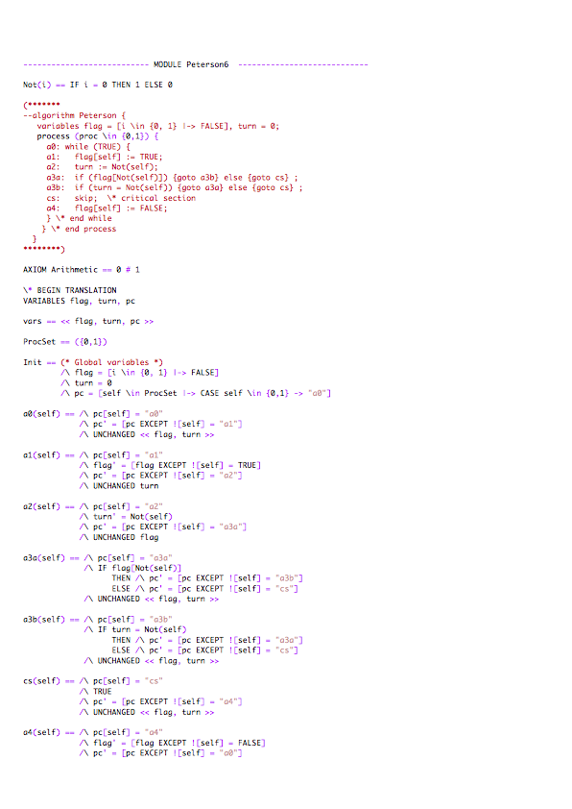

Slide 22
Track B
Computational Sciences
Scientific Information Interaction

Slide 23
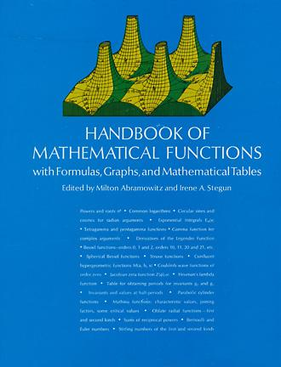

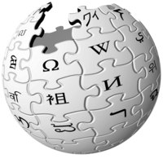
Dynamic Dictionary of math. functions
Bruno Salvy, INRIA Rocq.,
Alin Bostan, INRIA Rocq.,
Frédéric Chyzak, INRIA Rocq.
Alexandre Benoit, MSR-INRIA (intern)
Marc Mezzarobba, MSR-INRIA (intern)
Computer Algebra and Web for functions used by engineers
  easy interface
  dynamic tables of their properties
  generation of programs to compute them.

Slide 24
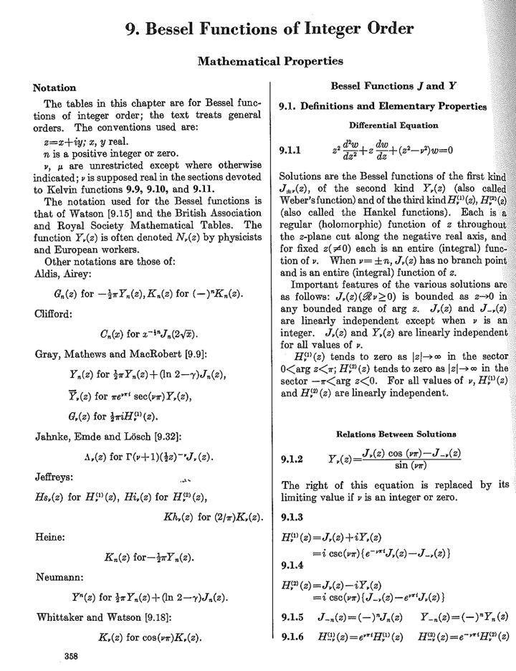
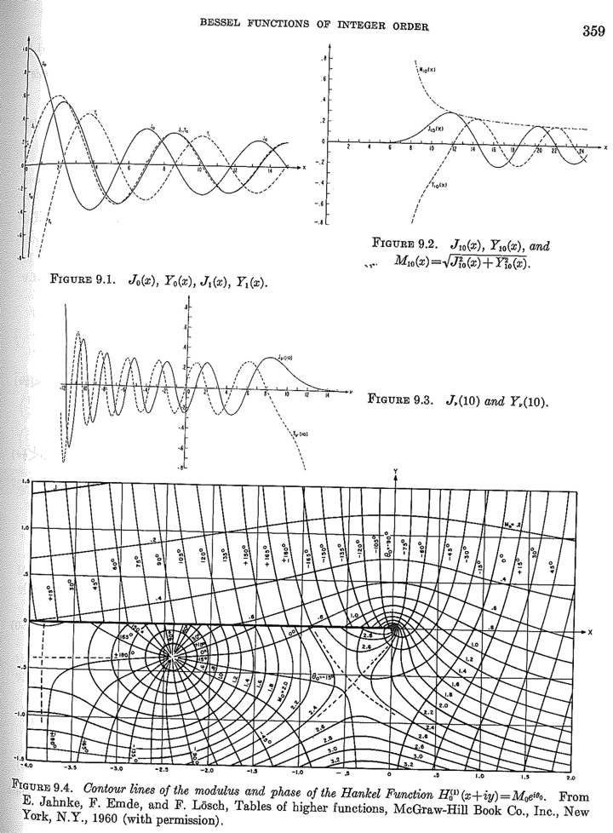

Slide 25
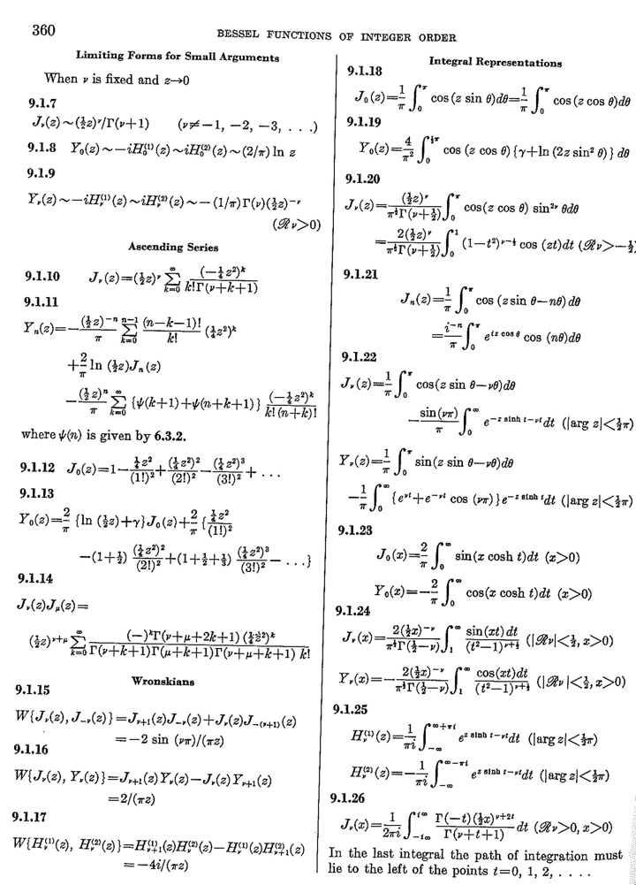
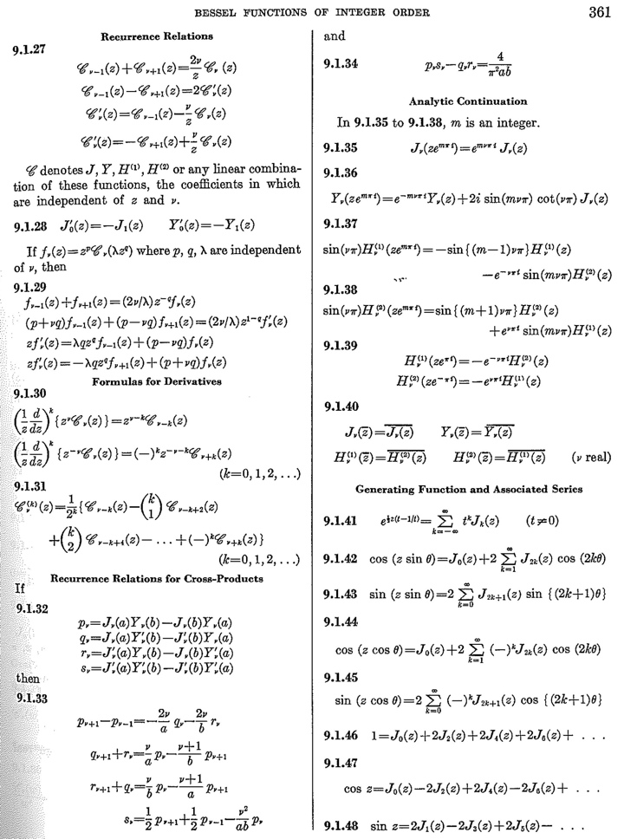

Slide 26
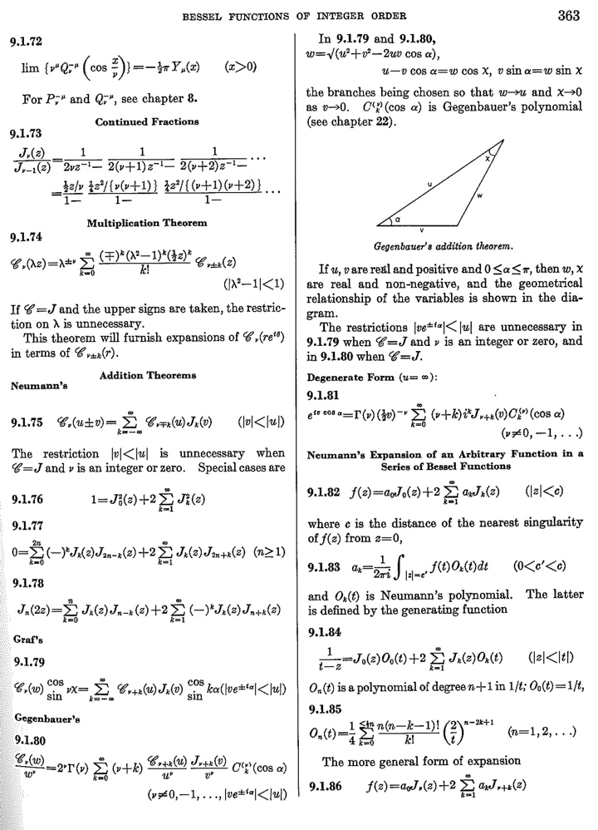
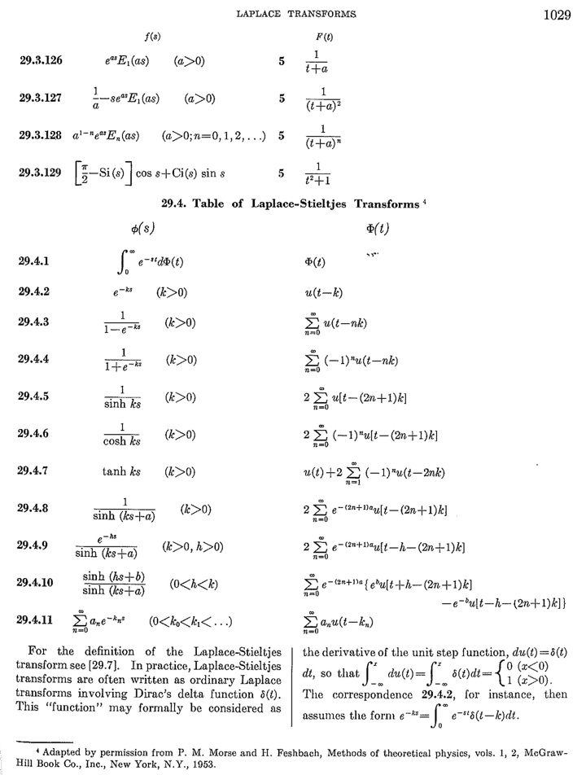

Slide 27
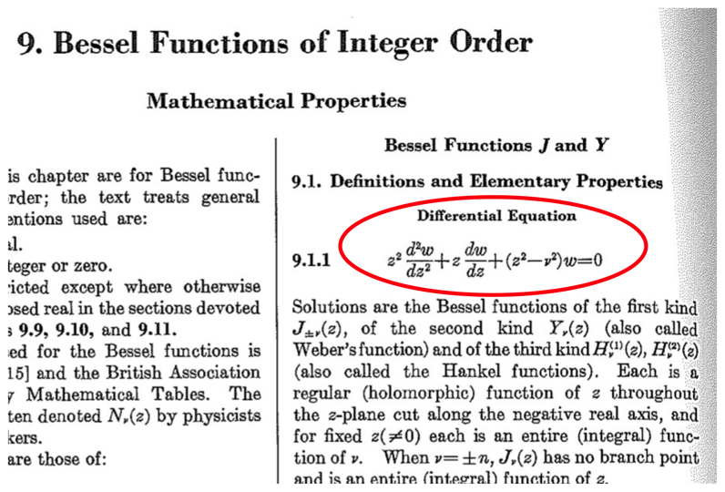

Slide 28
ReActivity
Wendy Mackay, INRIA Saclay,
J.-D. Fekete, INRIA Saclay,
  logs of experiments for biologists, historians, other scientists
Adaptive combinatorial Search
Youssef Hamadi, MSRC
Marc Schoenauer, INRIA-Saclay
  improve the usability of Combinatorial Search algorithms.
  automate the fine tuning of solver parameters.
  parallel solver: “disolver”

Slide 29
Cloud computing action
Gabriel Antoniu (INRIA Rennes)
Bertrand Thirion (INRIA Saclay)
correlation between Neurospin MRI images and genomic data
  thousands of most precise images
  thousands of genomic variables
with middleware of G. Antoniu
  BlobSeer (a la Map-Reduce) for grid machines
on top of Azure

Slide 30
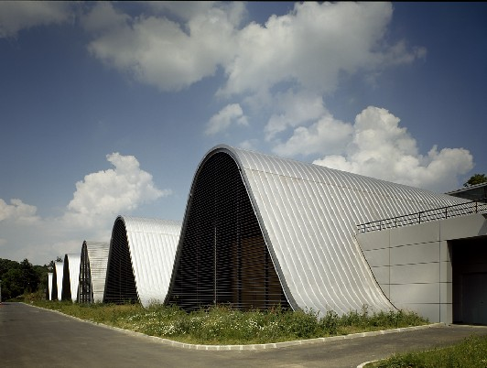

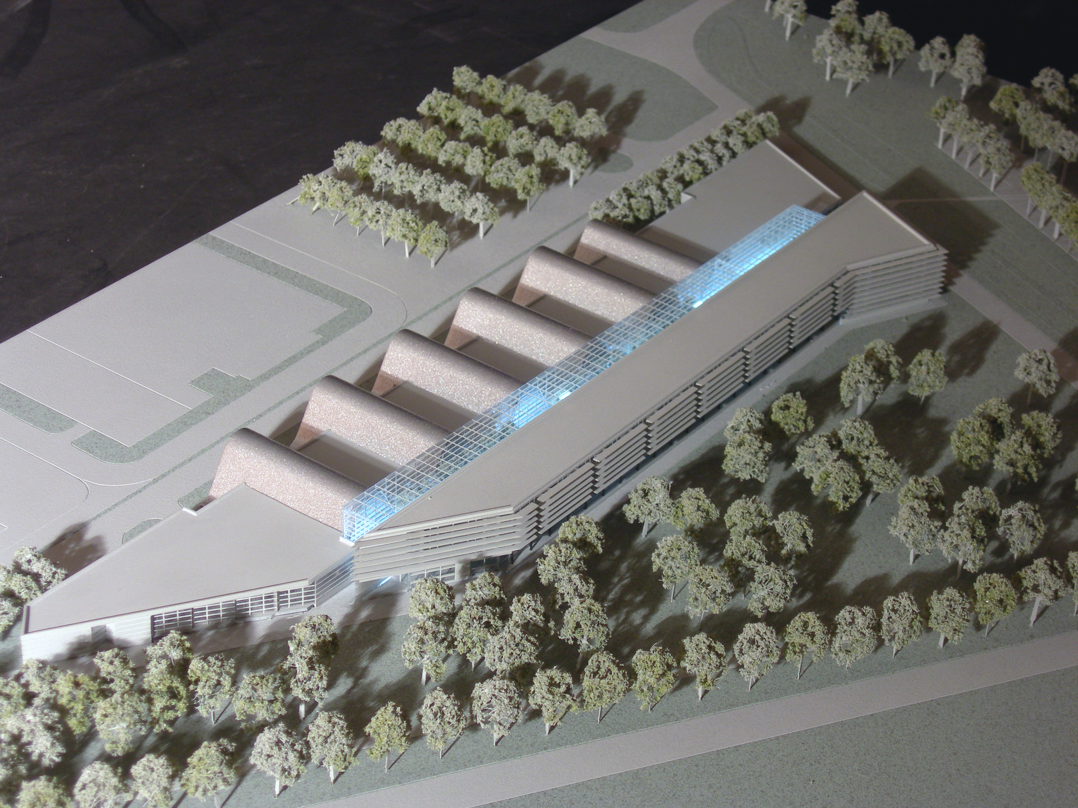
Cloud computing action
Neuroimaging center at Saclay
Clinical area
(8 hospital bed, neuro psy rooms, EEG / /MEG)
IRM 3T
IRM 7T
IRM 11.74T
logistic
Future scanner
Library and conférence room
17.65T/260mm
Laboratories and offices
Pre-clinecal area
(transgenic mice, primates, operating bloc, labs)
Notes:
30
Not a PLS expert but a user
this talk will not present theoratical developpement of PLS but pratical applications of it neuroimaging data

Slide 31
Image and Video mining
Jean Ponce, ENS
Andrew Blake, MSRC
Etienne Mémin, INRIA Rennes
Cordelia Schmid, INRIA Grenoble
Ivan Laptev, INRIA Rocq.
Josef Sivic, INRIA Rocq.
Rick Zelinsky, MSRR
Computer vision and Machine learning for:
  archaeology and cultural heritage preservation: 3D object modeling and recognition from historical paintings and photographs
  environmental sciences: change detection in dynamic satellite imagery
  sociology: human activity modeling and recognition in video archives

Slide 32
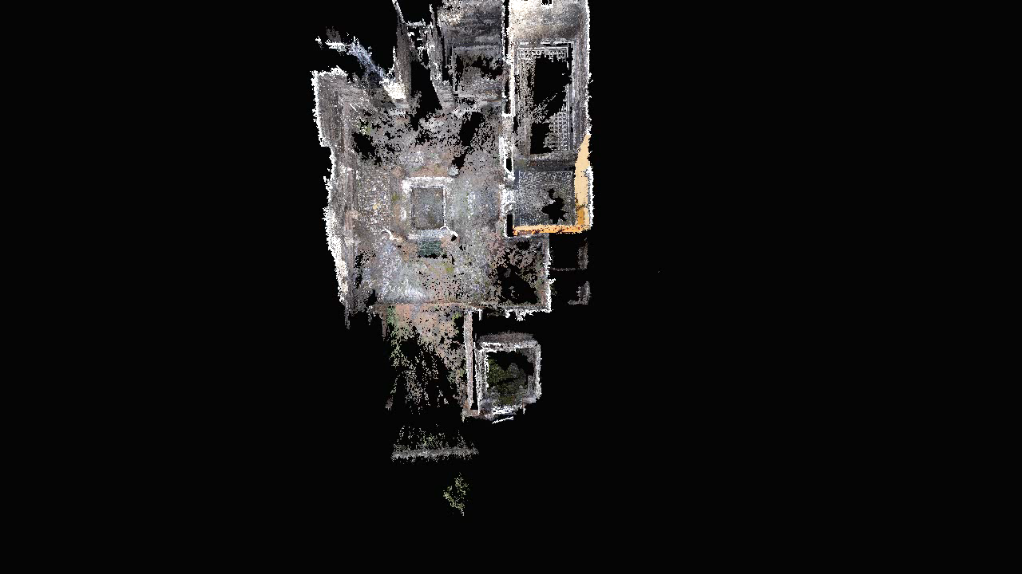
Image and Video mining
  archaeology and cultural heritage preservation: 3D object modeling and recognition from historical paintings and photographs

Slide 33
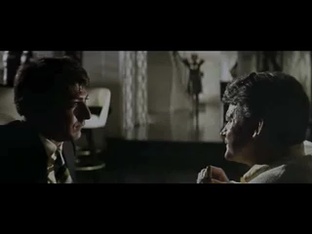
Image and Video mining
  sociology: human activity modeling and recognition in video archives

Slide 34
Conclusion

Slide 35
Logics in track A
Math. components | Coq | higher-order + reflection
Security | PV/CV | applied pi-calculus + stochastic
Spec. / Verif. | TLA+ | 1st order + ZF + temporal

Slide 36
Sciences in track B
DDMF | computer algebra | hard sciences
Adapt. search | constraints, machine learning | hard sciences, biology
Reactivity | chi + visualisation | soft sciences, biology
I.V. mining | computer vision | humanities, environment

Slide 37


